Slide 1


Hearts that Beat the Odds: An Analysis of the Fontan Procedure

Slide 2
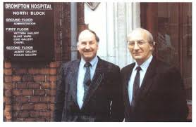

What is the Fontan Procedure?
1971: Francis Fontan and Eugene Baudet published Surgical Repair of Tricuspid Atresia [3]
A surgical operation used in children with single ventricle heart defects
Plumbing of the heart rerouted to allow blood flow straight to the lungs
It is usually the final step in staged reconstructive heart surgery
Drs. Fontan and Baudet visiting Brompton Hospital, March 1988
Notes:
Bypassing the need for the heart to pump blood to the lungs; passive flow
For conditions such as Tricuspid Atresia (TA) or Hypoplastic Left Heart Syndrome (HLHS)
Before, these infants received only palliative (comfort) care to mitigate issues until almost guaranteed passing away (within 1-year post-birth)

Slide 3
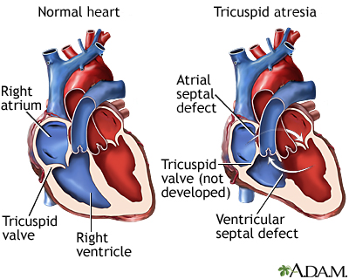
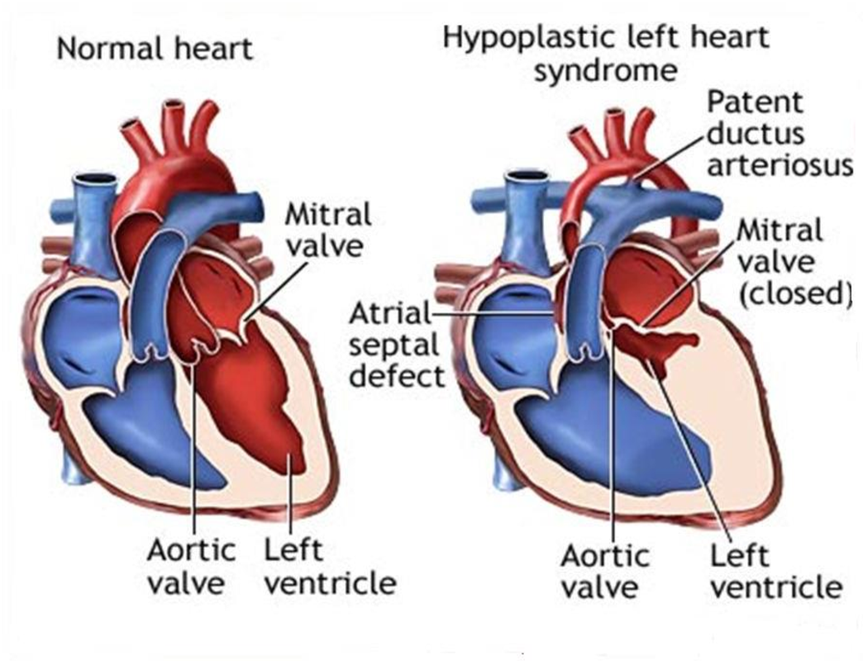




TA
HLHS
Normal heart
TA heart
Normal heart
HLHS heart
Single ventricle conditions such as Tricuspid Atresia (TA) or Hypoplastic Left Heart Syndrome (HLHS)

Slide 4
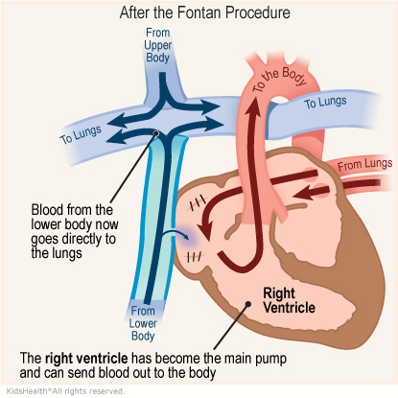
How the Fontan Procedure Works
Fontan paradox—good cardiac output achieved at cost of higher Fontan pressures and systemic venous congestion [3]
Elevated pressure ensures enough blood reaches the lungs to pick up oxygen despite passive flowing blood
The body can make adjustments that allow them to function under these conditions despite counterintuitive physiology

Slide 5
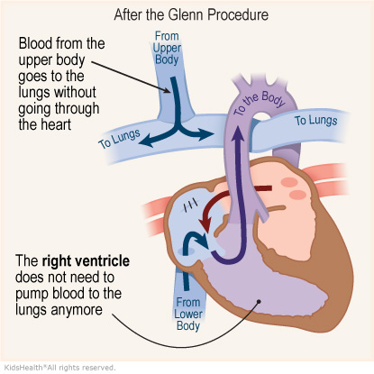
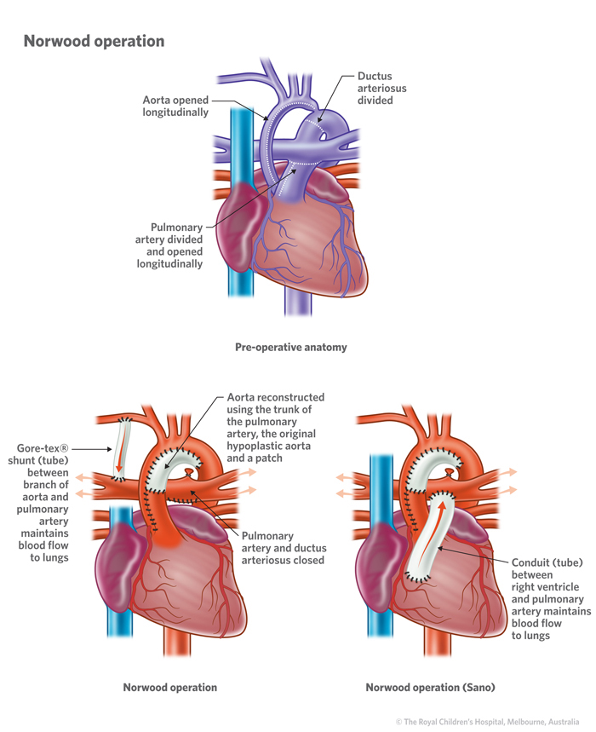
Stage 2
Glenn (1958)
Stage 1
Norwood (1978)
4-6 months post-birth
Stage 3
Fontan (1971)
Blaylock-Taussig-Thomas Sano shunt
(BT) shunt
First 28 days post-birth
2-4 years post-birth
Notes:
Norwood not always needed, depending on if aorta is developed
a Blaylock-Taussig-Thomas shunt, which moves blood from (and through) the aorta to the lungs.
a Sano shunt, which moves blood from the right ventricle to the pulmonary artery. From the pulmonary artery, the blood goes into the lungs.

Slide 6
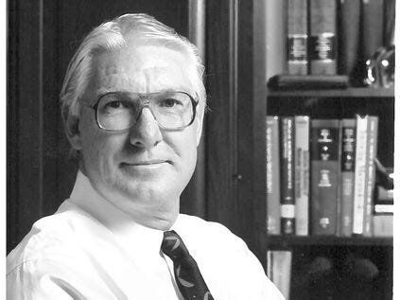
Necessity for 3-Staged Operation
In 1992, Dr. William Norwood discouraged single-stage Fontan procedures because of sudden changes in hemodynamics
Adversely alters the ventricular diastolic function.
Norwood presented a series of 100 consecutive 3 staged Fontan’s without any deaths. [3]
Dr. William Imon Norwood
Notes:
-Impaired relaxation during diastole leads to inadequate filling of the ventricles and thus, insufficient blood volume being pumped out to the body during the next heartbeat (vs contraction (systole))
-So, although all the stages developed out of order and decades apart, they realized the three together in this order brings best outcomes

Slide 7
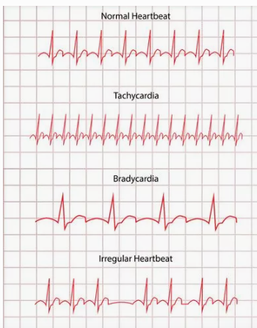
Major Long-Term Effects
All Fontan patients develop Fontan-associated liver disease (FALD)
Patients undergoing the Fontan operation usually develop arrhythmias
One study reported after 20 years post-Fontan, freedom from arrhythmias is only 60%
[1]
Notes:
Many organs in body take a toll, but one can live healthily with fontan for 40, 50, 60+ years!

Slide 8
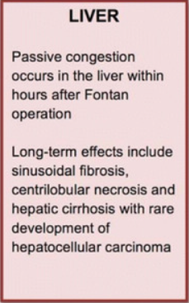
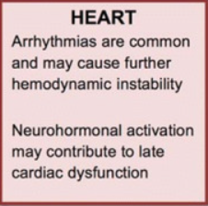
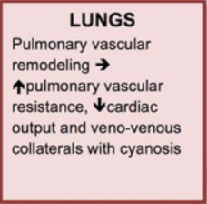
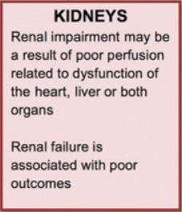
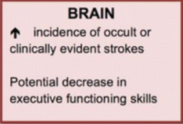
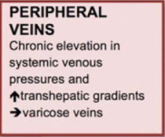
Post Fontan Complexities

Slide 9


Conclusion
The Fontan operation is a cornerstone of hope in pediatric cardiology, dramatically enhancing life prospects for children with complex heart conditions

Slide 10
Works Cited
[1] Aurora, Ruth Grace, et al. “Impact of Older Age at Fontan Completion on Mid-Term Survival.” The Egyptian Heart Journal : (EHJ) : Official Bulletin of the Egyptian Society of Cardiology, U.S. National Library of Medicine, 15 Oct. 2022, www.ncbi.nlm.nih.gov/pmc/articles/PMC9569401/.
[2] Cowgill, L. Douglass. “The Fontan Procedure: A Historical Review.” The Fontan Procedure: A Historical Review, Department of Surgery, Dean Medical Center, Madison, Wisconsin , www.annalsthoracicsurgery.org/article/0003-4975(91)91044-V/pdf. Accessed 28 Mar. 2024.
[3] Talwar, Sachin, et al. “Where Are We after 50 Years of the Fontan Operation?” Indian Journal of Thoracic and Cardiovascular Surgery, U.S. National Library of Medicine, Jan. 2021, www.ncbi.nlm.nih.gov/pmc/articles/PMC7858722/#:~:text=The%20Fontan%20operation%20was%20introduced,tricuspid%20atresia%27%20%5B1%5D.

